Slide 1
Introduction
Our project is about how to make a path planning and navigation of autonomous robot for indoor environment.
There are the following difficulties in achieving this,
navigate the robot to its destination without colliding obstacles.
keep track of obstacles in the robot’s path because of other obstacles in the whole environment.
To get rid of these problems, we are going to use external cameras mounted on the room tops.

Slide 2
Objective
Main purpose:
Having a navigation system for internal robots by directing it with an external vision to oversee the entire navigation area.
In order to achieve this, we are going to deal with our project into three parts as below,
Customer order management system
External vision based path planning
Robot’s hardware and control system

Slide 3
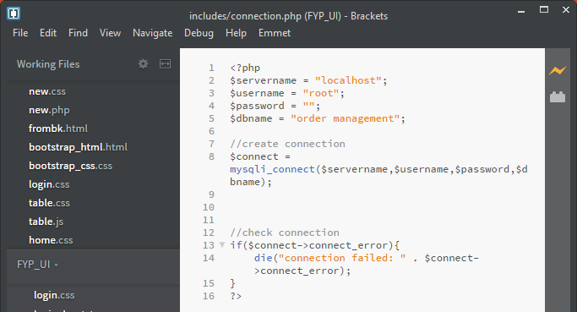
1. Order Management System
User interaction can be given via handheld device at the table.
For the purpose for creating web application, we have to deal with a scripting language(PHP), a web server(Apache) and a database(MySQL). Now we are using XAMPP which is combined with X-OS (cross platform), Apache, MySQL and PHP.
Figure 1: Php code to make connection
to server

Slide 4
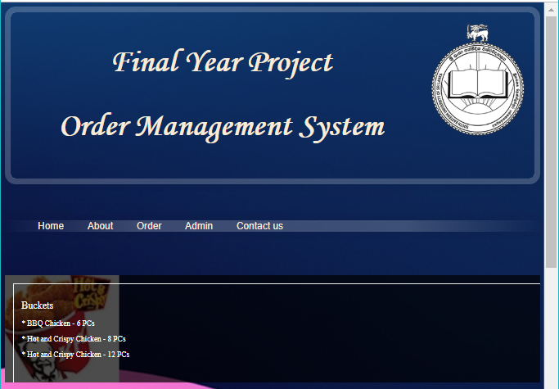
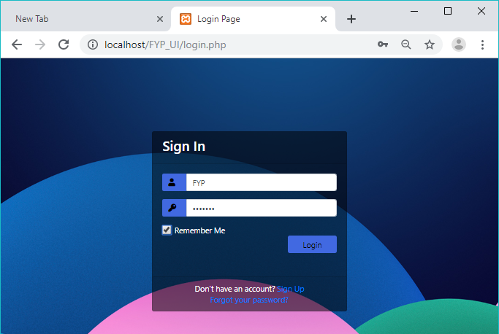
Webpage mainly deals with the admin interface for kitchen administration and the user interface for customer to utilize ordering. Login page decides who will be going to use the web application.
User can go for ordering page by tapping “Order” menu while admin can login through by tapping “Admin” menu.
Figure 2: Home page
Figure 3: login window for enter to the administration page

Slide 5
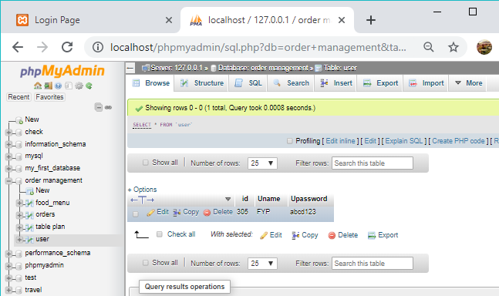
Admin can update their valid username and password in database. Hence no one can enter the admin page by login. If we enter the correct password server will check the details in database and it will allow to the admin page.
Figure: login data in the database

Slide 6
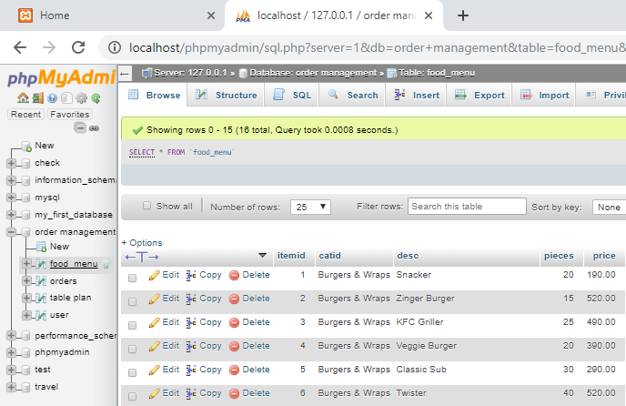
Admin should be responsible for updating the food availability and the order details in the database. Then it will be shown in customer’s ordering page.
Figure: food available list in the database

Slide 7
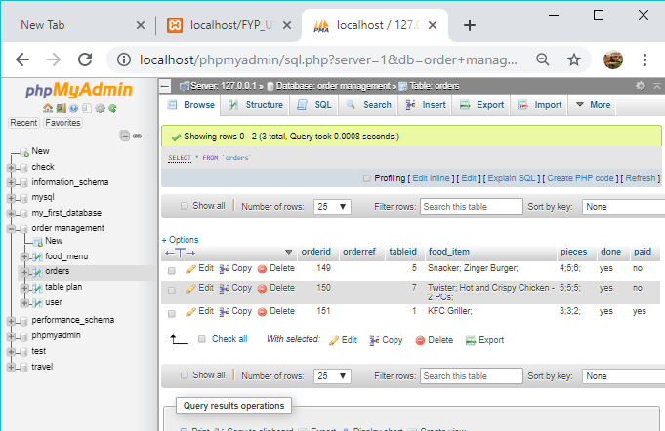
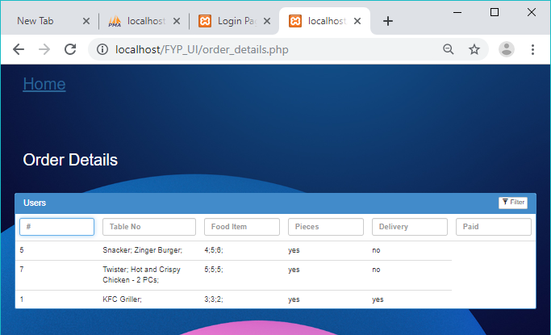
Selected foods by customer can be send through the admin page by getting data from database.
Figure 4: food order list in the database
Figure 5: food order list in the user window

Slide 8
User interface can be used for ordering the food, table reservation and payment.
Admin interface can be used for order updates, food availability and will give notification to the robot.
Until now, we finished the following tasks,
Create Interface for customer and admin
Receive order from webpage and update it in database
Connect database to the webpage and update the orders in admin page
We try to complete the OMS with some features as given below,
Organize the webpage for payment
Track the status of the order

